Slide 1
Configuration Management
Building Landscapes

Slide 2

Agenda
Why SCM ?
What is SCM ?
What is not ?
What SCM do ?
The scope
Tooling Landscape
Without puppet ?
What puppet does ?
How Puppet do ?
Components
Advance learning

Slide 3
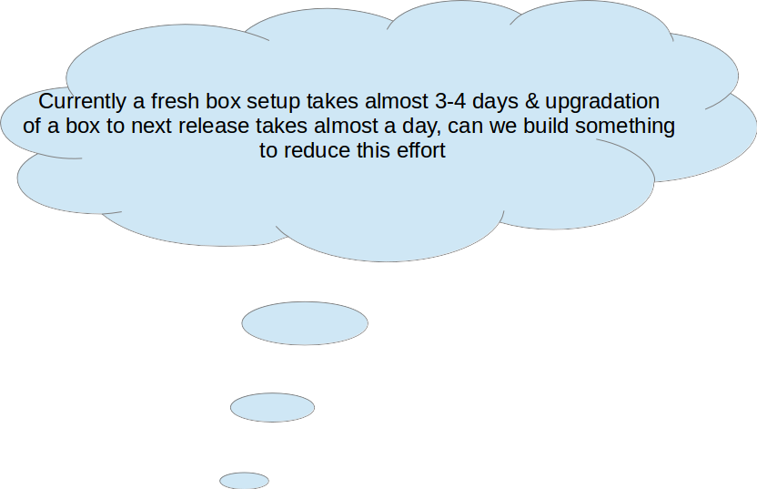

Slide 4
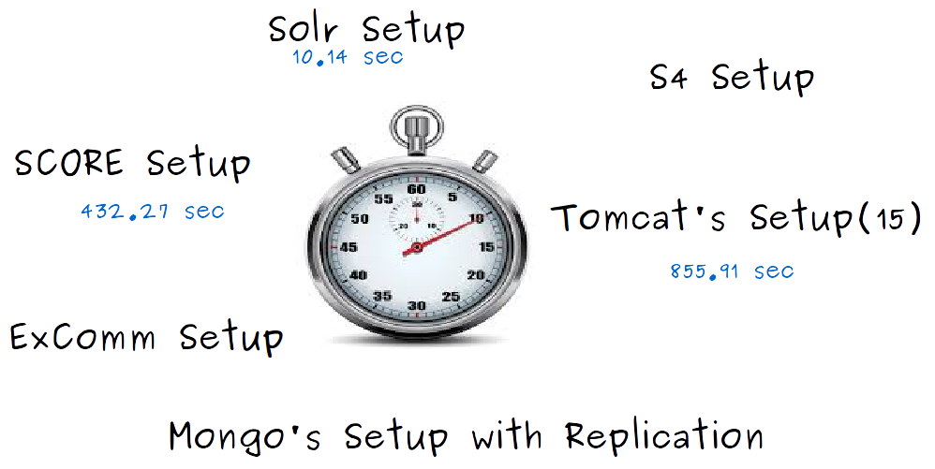

Slide 5
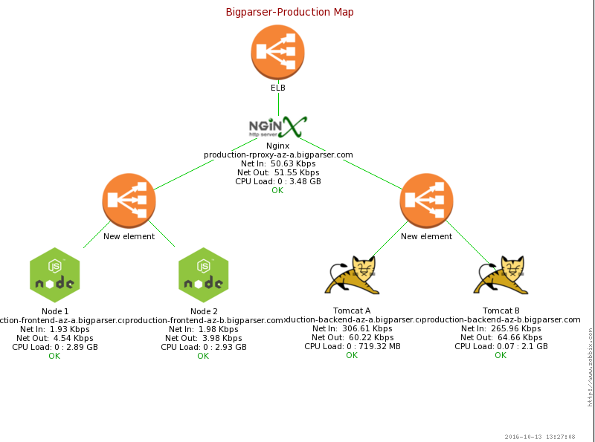

Slide 6

Why SCM ?
Increased efficiencies, stability and control by improving visibility and tracking
Cost reduction by having detailed knowledge of all the elements
Enhanced system reliability
Faster problem resolution
Decreased risk and greater levels of security.
Faster restoration

Slide 7



Without SCM
Manual Installation
Login and perform installation/config changes ad hoc scripts/tools
Not scalable
Everyone solving same problems their own way boring

Slide 8

SCM
Configuration management is a discipline to measure the configurational requirement of a server and systematically handling changes to a system in a way that it maintains integrity over time.
Broadly used to refer to server configuration management
Automation plays an essential role in server configuration management.

Slide 9

What is not ?
Just version management
Just change management
Just a build and release tool
An administration tool

Slide 10

What SCM do ?
SCM activities are developed to:
Identify the change
Control change
Ensure that change is being properly implemented
Report changes to others who may have an interest
Notes:
Introduce the term Idempotency

Slide 11




Tooling Landscape

Slide 12
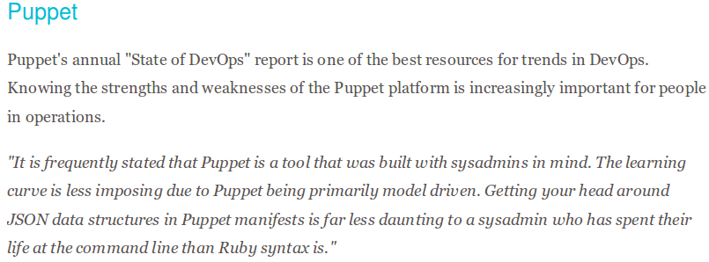
Notes:
Talk about hiera, foreman
Talk about case study of Panthacorp
Talk about convention over configuration

Slide 13
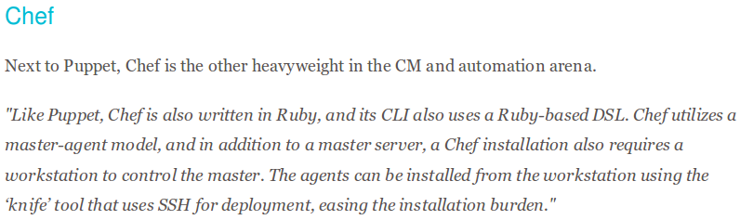
Notes:
Talk about it’s architecture flow, Knife, kitchen,
Talk about case study of Barclays
Draw the analogy of Maven & Puppet

Slide 14
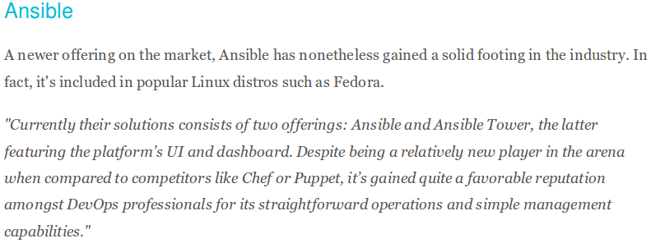
Notes:
Talk about why I’m so excted about Ansible how it is different from standard DevOps tools.
Use cases of Ansible
Infra setup
Deployment
Server Administration
Infra Management

Slide 15
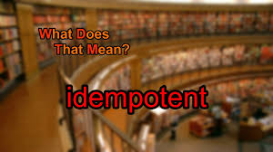

Slide 16
High level flow ?
Vanilla Server
Your Desired Server
Apply Puppet
Before
Transformation
After

Slide 17


Slide 18

Components
Resources
Manifests
Classes
Templates
Files
Facts
DSL language
Notes:
Draw parallel with Chef
Resources = Resources
Manifests =

Slide 19
Facter & facts
Puppet Language
templates
Manifests
Puppet uses facter to gather information about the host system
DSL
ruby
puppet uses ruby erb templating system
file {/etc/foo.conf:
ensure => file,
require => Package[foo], content => template(foo/foo.conf.erb),
}
puppet programs are called “manifests”file extension: .pp

Slide 20
Resources
classes
The building blocks
model system configurations
built-in resources
user { sandeep: ensure => present, home => /home/dave, shell => /bin/bash }
puppet describe -s user
Logical grouping of resources, files and templates
not object-oriented programming class

Slide 21

Puppet Resources
File
Exec
Group
Host
Package
sshkey
User
Service

Slide 22

Group Resource
Manage groups. On most platforms this can only create groups. Group membership must be managed on individual users.
group { ‘sandy’:
name => 'puppet',
ensure => 'present'
}

Slide 23

User Resource
Manage users. This type is mostly built to manage system users, so it is lacking some features useful for managing normal users.
user { 'daemon': ensure => 'present', home => '/sbin', uid => '2', shell => '/sbin/nologin', password => '*', gid => '2', groups => ['bin','daemon','adm','lp'], comment => 'daemon' }

Slide 24

File Resource
This can be used to manage files, directories and symlinks, the type should be specified in ensure attribute.
Possible values of ensure are present,absent,file,directory, link. Below e.g create a file, ensure it’s created,manage permissions with correct ownership.
file { '/path/to/file':
ensure => 'present',
owner => 'vagrant',
group => 'vagrant',
mode => '0666',
}

Slide 25

Exec Resource
Any command in an exec resource must be able to run multiple times without causing harm — that is, it must be idempotent. There are three main ways for an exec to be idempotent:
The command itself is already idempotent. (For example, apt-get update.)
The exec has an onlyif, unless, or creates attribute, which prevents Puppet from running the command unless some condition is met.
The exec has refreshonly => true, which only allows Puppet to run the command when some other resource is changed
exec { 'tar -xzf /root/apache-tomcat-7.0.70.tar.gz':
cwd => '/root/puppetResource',
path => '/usr/bin:/bin/tar:/bin',
}

Slide 26

Host Resource
Installs and manages host entries. For most systems, these entries will just be in /etc/hosts, but some systems (notably OS X) will have different solutions.
host { 'abc':
name => 'opstree.example.com',
ensure => 'present',
comment => 'opstree server entry',
ip => 'xxx.xxx.xxx.xxx',
}

Slide 27

Package Resource
Manage packages. There is a basic dichotomy in package support right now: Some package types can retrieve their own package files, while others cannot. For those package formats that cannot retrieve their own files, you can use the source parameter to point to the correct file.
package { 'openssl': ensure => installed, name => openssl, }

Slide 28

Service Resource
Installs and manages ssh host keys. By default, this type will install keys into /etc/ssh/ssh_known_hosts.
service { 'apache2': ensure => running, enable => true, }

Slide 29

SshKey Resource
Installs and manages ssh host keys. By default, this type will install keys into /etc/ssh/ssh_known_hosts. To manage ssh keys in a different known_hosts file, such as a user’s personal known_hosts, pass its path to the target parameter..
sshkey { 'abc':
name => 'opstree',
ensure => 'present',
key => 'AAAAB3NzaC1yc2Pu+KhM9M5hku9wpEetz8E8drNkKwuRvlCoSCwPidysk/oKSe4IDHuSDbhYRDRQJzNH3Dk56J3H/wxSgQOuW5z4bzb9S/oAUN99CLHhDmtA5jGqPdP5A12LLXEE8CH2y2lgGpdfghgtf==n',
type => 'ssh-rsa',
target => '/root/puppetResource/opstree_rsa.pub'
}

Slide 30
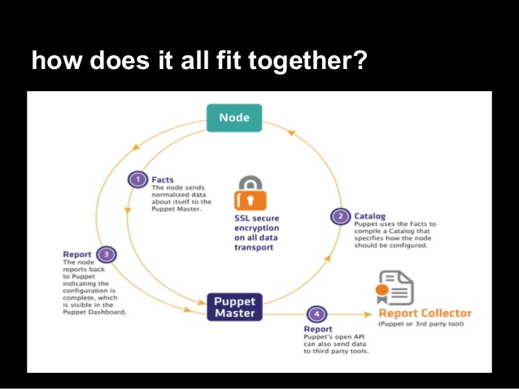
How does it all fit together ??

Slide 31

Hands On using Puppet
Install java using puppet
Install tomcat using puppet
Install and configure mysql using puppet
Install jenkins using puppet and configure it

Slide 32
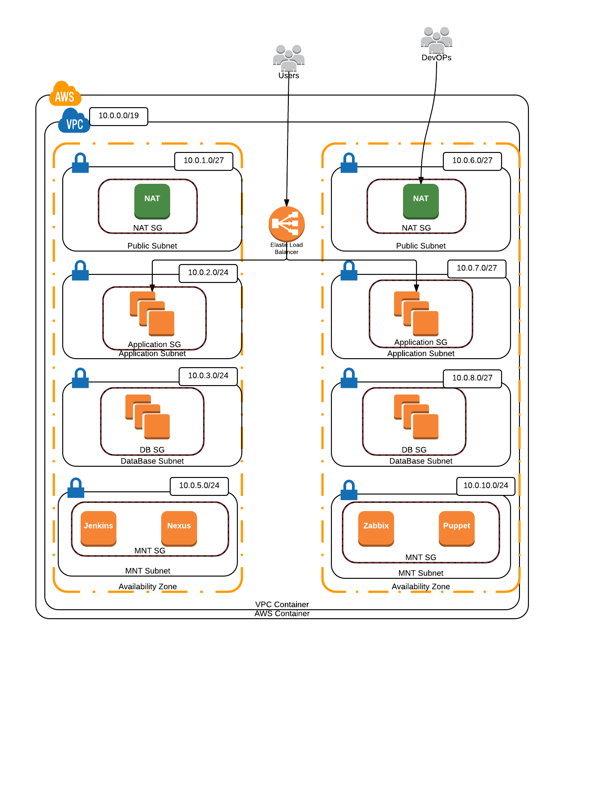

Slide 33
Advance learning
Hiera
https://docs.puppet.com/hiera/3.1/
MCollective
https://docs.puppet.com/mcollective/
Foreman
https://theforeman.org/

Slide 34

Questions ??

